Slide 1
ΒΑΚΤΗΡΙΑ ΜΕ ΥΠΕΡΔΥΝΑΜΕΙΣ
Bacteria with Superpowers
21/09/2023

Slide 2
Have you ever wondered why are your parents always telling you to wash your hands and eat all your fruit?
Notes:
Εδώ να πούμε προφορικά ότι με το ένα διωχνεις τα κακα βακτηρια κ με το άλλο βοηθάς τα καλά βακτήρια κ να ρωτήσουμε ποιος εχει ξαναακουσει αυτή τη λεξη τι είναι

Slide 3
WHAT ARE BACTERIA?
Tiny little creatures, even smaller than the ants
You cannot see them with your bare eyes, you need
a specific instrument called the microscope!

Slide 4
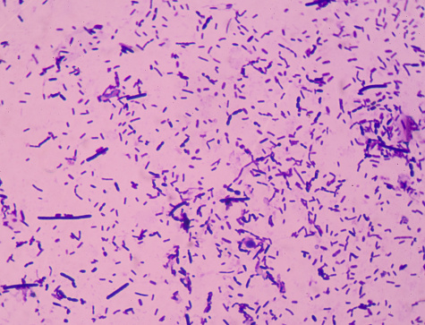
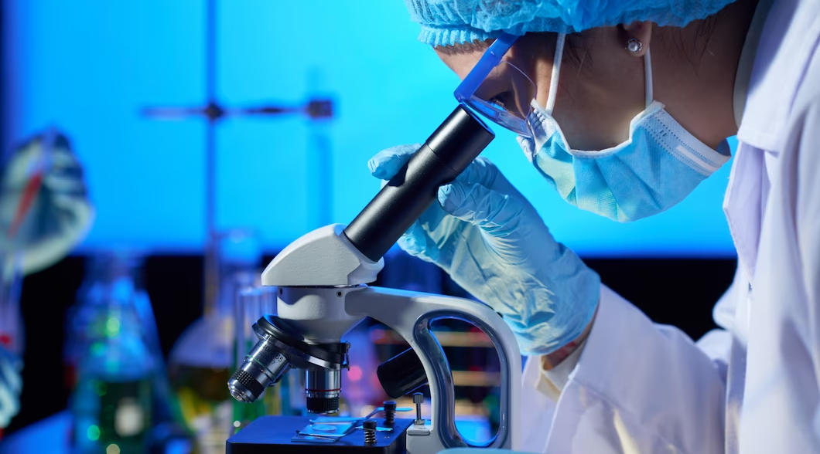
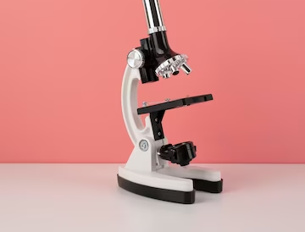

Slide 5
BUT WHERE ARE THESE BACTERIA LOCATED?
EVERYWHERE!!!
On top of animals…
Even inside of us!
Over objects, like chairs…
On the ground…

Slide 6
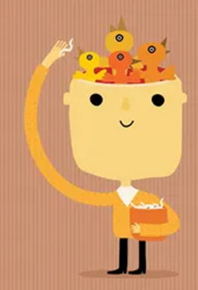
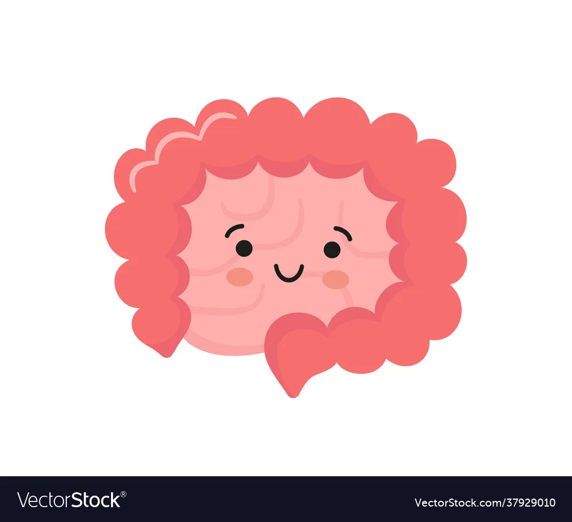
INSIDE OF US? AND WHAT ARE THEY DOING IN THERE?
They are producing vitamins that we can’t produce on our own!
They are fighting other evil bacteria that are trying to hurt us!
They are helping us sleep tight!
They are keeping us happy and healthy!
Notes:
Sta kak bakt na poume oti tha milhsoume g ayta argotera

Slide 7
That’s why we should take care of our good bacteria!
How can I do that?
By eating food like
Yoghurt
Fruit
Vegetables
By sleeping well
By working out regularly

Slide 8
However, not all bacteria are our friends...
Some bacteria make us sick…
Should we be afraid of those bacteria?
NO! As long as we wash our hands, we don’t put our hands in our mouths and we take showers, we have nothing to fear! Bad bacteria are afraid of cleanness!

Slide 9
DID YOU KNOW…?
Scientists can transform bacteria, giving them unique superpowers like:

Slide 10
To produce medicine on their own
To ‘’eat’’ the garbage we produce, keeping the environment clean
To understand whenever you are sick
To protect plants and flowers
They can even travel to space!

Slide 11
WE ARE MADE OUT OF CELLS

Slide 12
SOMETIMES, CELLS GET SICK …
AND MAYBE A BACTERIUM SUPERHERO CAN HELP
SICK CELLS TURN HEALTHY AGAIN !

Slide 13
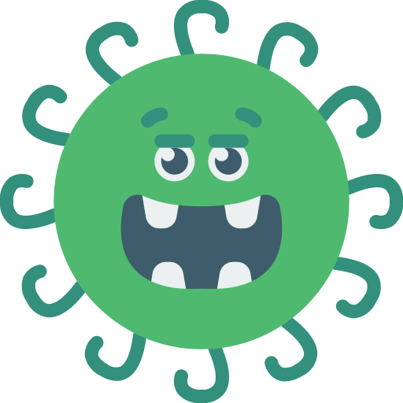
WHAT SUPERPOWER WOULD YOU GIVE TO A BACTERIUM ?

